Slide 1
INTRODUCTION. USING VERSION CONTROL SYSTEM
Continous staff improvement project
YURII HOHAN

Slide 2
INTRODUCTION
INTERNSHIP OVERVIEW AND GOAL
PROCESS
ROLE OF A SOFTWARE ENGINEER

Slide 3
INTERNSHIP OVERVIEW AND GOAL
Internship will contain four courses one built on top of the another:
Your final goal you will be working towards the whole internship is a small NTier Web application covered with tests.
The application’s functionality should be a CRUD (create, update and delete) on the chosen domain.
You will be prepared to become a Junior .NET Developer
Course name | Time (%)
1. Basic C#, .NET Framework and OOP. SOLID | 40
2. Database access: T-SQL / ORM / NHibernate | 20
3. Web Applications: ASP.Net MVC / JQuery | 30
4. Communication: ASP.Net WebApi / WCF | 10

Slide 4
THE PROCESS
Each day a 2 hour lecture on the topic.
Either a 5 hour practical assignment or 4 hours of studies followed by a quiz.
If the topic is practical (most of them are), the task will be to write some code. The result of the code review will be reflected in the mark. If the topic is theoretical, the mark will be obtained during the quiz.
Each separate task will be assessed with a mark daily and each separate course will be assessed with a mark during exam. The final mark should be calculated as:
Final_mark = 50% * average_daily_assessment_mark + 50% * exam_mark

Slide 5
SOFTWARE ENGINEERING
Typical formal definitions of software engineering are:
"research, design, develop, and test operating systems-level software, compilers, and network distribution software for medical, industrial, military, communications, aerospace, business, scientific, and general computing applications.“
"the systematic application of scientific and technological knowledge, methods, and experience to the design, implementation, testing, and documentation of software"
"the application of a systematic, disciplined, quantifiable approach to the development, operation, and maintenance of software"
An engineer is a professional practitioner of engineering, concerned with applying scientific knowledge, mathematics, and ingenuity to develop solutions for technical, societal and commercial problems.
Ingenuity is the quality of being clever, original, and inventive, often in the process of applying ideas to solve problems or meet challenges

Slide 6
HOW IS TIME SPENT
A rule of thumb for scheduling a software task (Fredrik Brooks):
1/3 planning
1/6 coding
1/4 component test and early system test
1/4 system test, all components in hand.

Slide 7
THE JOYS OF THE CRAFT
First is the sheer joy of making things. As the child delights in his mud pie, so the adult enjoys building things.
Second is the pleasure of making things that are useful to other people.
Third is the fascination of fashioning complex puzzle-like objects of interlocking moving parts and watching them work in subtle cycles.
Fourth is the joy of always learning, which springs from the nonrepeating nature of the task.
The delight of working in such a tractable medium. The programmer, like the poet, works only slightly removed from pure thought-stuff. He builds his castles in the air, from air, creating by exertion of the imagination

Slide 8
THE WOES OF THE CRAFT
First, one must perform perfectly.
Other people set one's objectives, provide one's resources, and furnish one's information. One rarely controls the circumstances of his work, or even its goal.
Dependence upon other people's programs (which are not perfect).
The product over which one has labored so long appears to be obsolete upon
(or before) completion.

Slide 9
CONSTRUCTS TO DISCUSS
PESSIMISTIC AND OPTIMISTIC LOCKING
WHAT IS UPDATE
WHAT IS COMMIT
TYPES OF CONFLICTS
BASIC BRANCHING

Slide 10
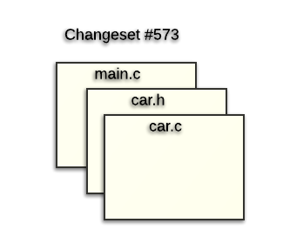
VERSION CONTROL SYSTEM MOTIVATION
Version control is a system that records changes to a file or set of files over time so that you can recall specific versions later
It can be useful not only for a developer, but also for a graphic designer, web designer.
It is like a “time machine”!
You can recover an older version
Examine the history of the project
Resolve conflicts when working in a team
Have many versions of the product easy to control
Repository is the store of the project’s data
Changeset - a group of changes made in different files.

Slide 11
MODELS OF VCS
Client-server model (Centralized)
1. Uses Client-Server architecture
Based on the idea that there is a single “central” copy of the project somewhere on the server.
All programmers “commit” their changes to the central repository
Examples : CVS, SVN, TFS, etc
Distributed model
Uses distributed architecture
Based on the idea that each developer has its own repository with whole history.
All programmers can synchronize their changes between each other without any central repository
Examples: Mercurial, Git, Bazaar

Slide 12
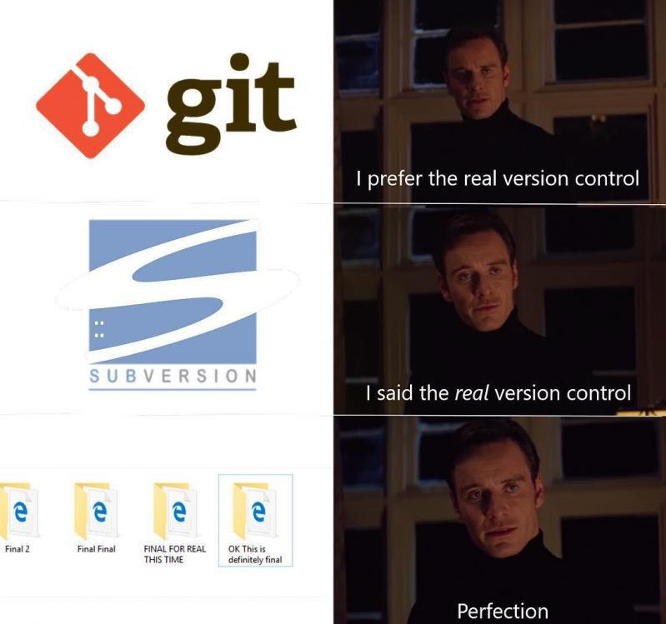

Slide 13
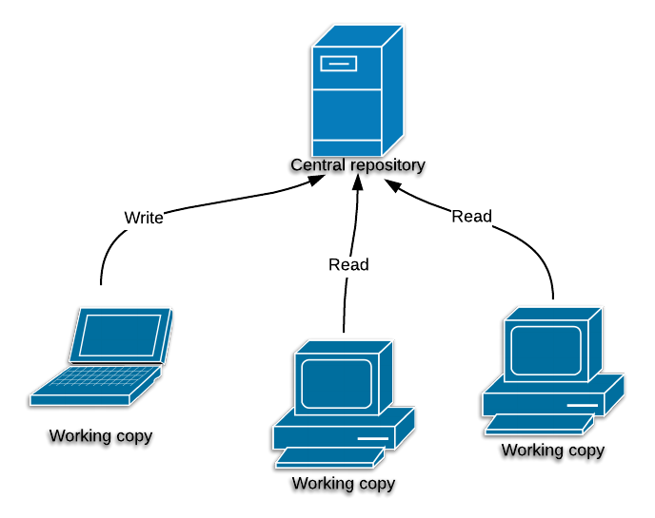
CENTRALIZED VCS
The main authority is repository server. The server keeps the entire history of all changes.
All developers know only about the central repository server. All changes are sent to central server. In order to share a change with another developer the change must be “committed” to server.
Each developer has its own working copy on local machine. Working copy is a snapshot of files at certain point in time.

Slide 14
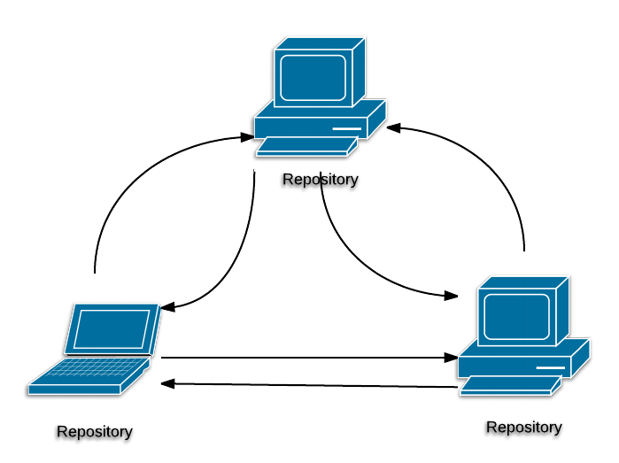
DISTRIBUTED VCS
Each developer has its own copy of repository with all changes.
Each repository can be connected with as many repositories as needed
Developer commit to local repository its changes.
Developer can choose which changes to synchronize with other repositories.

Slide 15
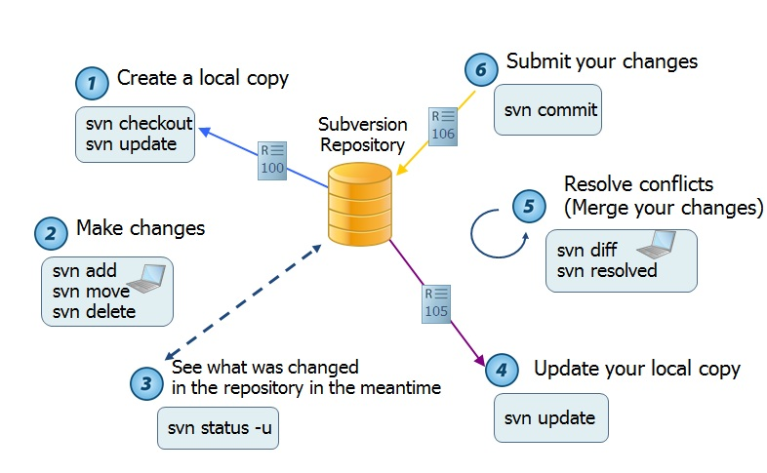
WORKING PROCESS IN CENTRALIZED VCS

Slide 16
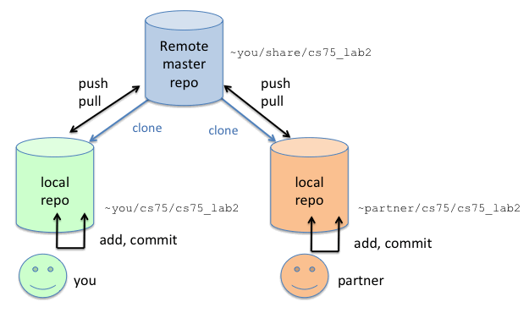
WORKING PROCESS IN DISTRIBUTED VCS

Slide 17
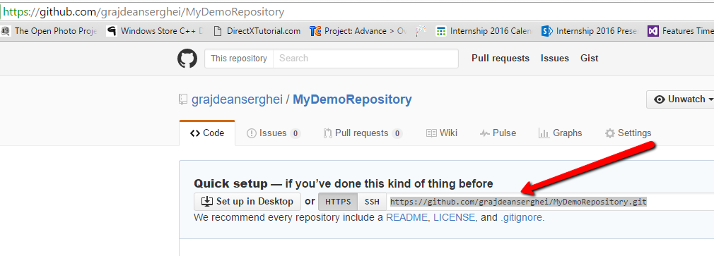
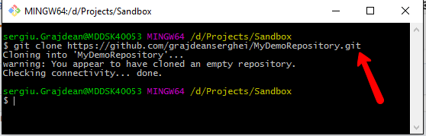
CHECKOUT REPOSITORY
1
2

Slide 18
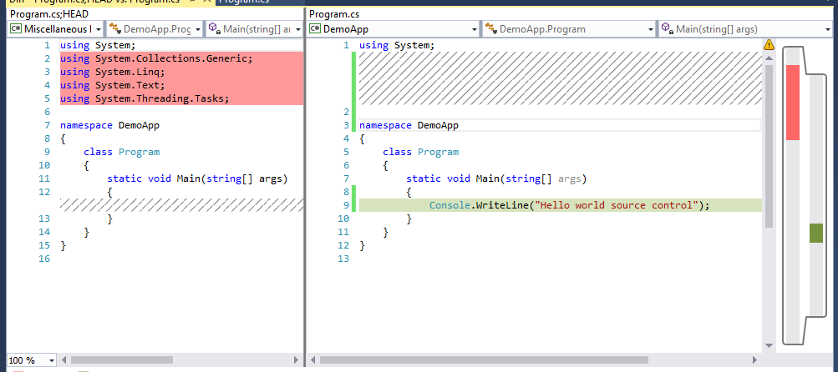
VISUAL STUDIO DIFF TOOL
Shows the difference between two version of file

Slide 19
TEXT CONFLICT
Text conflicts happen when local changes have been made to a file and remote version also include changes to the file in such a way that it can not be automatically determined how they should be merged.
<<<<<<< HEAD:mergetest
This is my third line
=======
This is a fourth line I am adding
>>>>>>> 4e2b407f501b68f8588aa645acafffa0224b9b78:mergetest

Slide 20
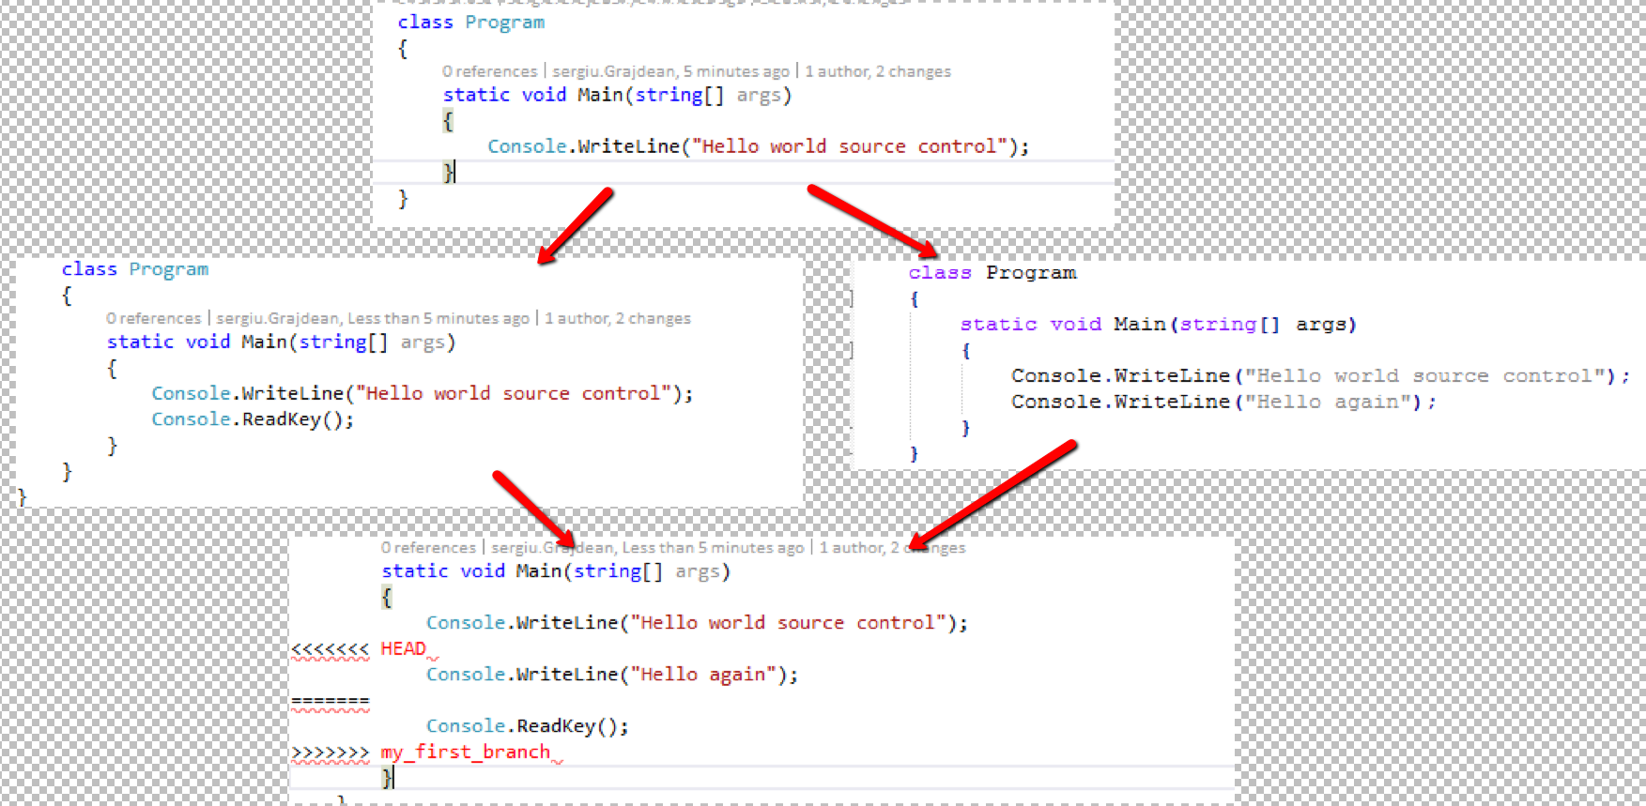
TEXT CONFLICT

Slide 21
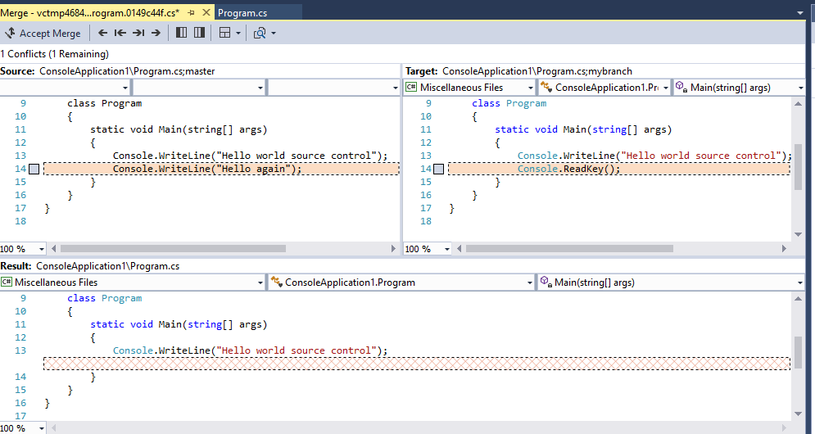
VISUAL STUDIO TEXT CONFLICT EDITOR

Slide 22
REMOVED FILE CONFLICT
Removed file conflict occurs when one person edits a file, and another person deletes that file in their branch.
Removed file conflict can be resolved in following ways:
1. Resolving by keeping the edited file
2. Resolving by removing the file

Slide 23

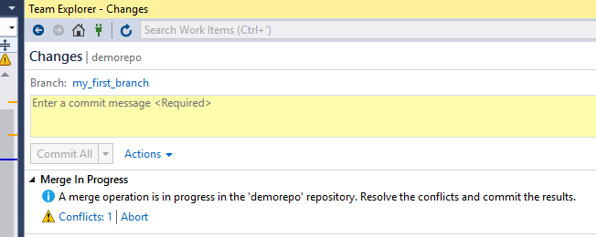
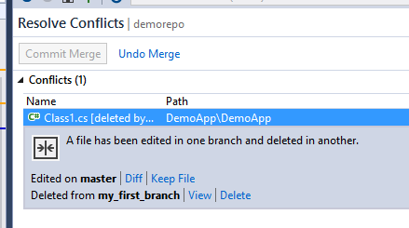
REMOVED FILE CONFLICT

Slide 24
LOCKING IN CENTRALIZED VCS
There are two forms of concurrency control that we can use in centralized VCS: optimistic and pessimistic locking.
Let us suppose that Mark and Albert are going to edit the same file containing info about sales.
With pessimistic locking whoever checks out the file first prevents anyone else from editing it. So if Mark is first to check out, Albert can't work with the file until Mark is finished with it and commits his changes.
With optimistic locking both of them can make a copy of the file and edit it freely. Mark and Albert can work on the file simultaneously, the first of them, Mark, will commit the file without problems and Albert will have to deal with the conflict during his commit (depending on the sophistication of the system).

Slide 25
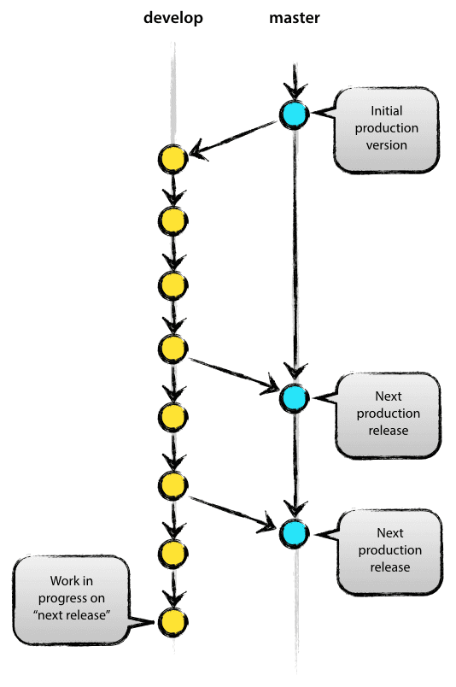
BASIC BRANCHING
Branch is a copy of an object under revision control which has it’s own history. Branch is like a nested repository inside the repository.
One repository must have at least one branch.
Branch allows to work parallel and isolated on different versions of source code.

Slide 26

BRANCH PER FEATURE
Branch per feature is development process when each new User story/feature is done in its own branch.
Branch per feature allows maintain main branch in stable state, releasable at any time.
Feature branch is merged in main branch when the work is done.

Slide 27
GIT SPECIAL FILES
.gitignore – specifies intentionally untracked files that Git should ignore. Almost all VCS contains such file.
.gitattributes – defines attributes for path names. Usually is used to specify line endings.

Slide 28
MAIN GIT COMMANDS
git clone – creates a new local copy of remote repository
git add – adds pending changes to index
git commit – creates new commit
git status – shows status of working tree
git pull – get changes from remote repository branch
git push – sends local commits to remote repository
git checkout – switches working branch
git branch – shows local branches
gitk – Visualize the commit graph, showing the information related to each commit

Slide 29
ASSIGNMENT
CREATE A REPOSITORY IN THE VERSION CONTROL SYSTEM OF YOUR CHOICE (SVN, TFS OR GIT).
DO SEVERAL TEST COMMITS.
REPRODUCE A SITUATION FOR A TEXT CONFLICT AND EXPLAIN HOW YOU RESOLVED IT.
REPRODUCE A SITUATION FOR A DELETED FILE CONFLICT AND EXPLAIN HOW YOU RESOLVED IT.
CREATE A BRANCH FROM MASTER/TRUNK AND DO SEVERAL COMMITS TO BRANCH AND MASTER.
MERGE AND DELETE THE BRANCH.

Slide 30
REVISIONS
REVISIONS
Number | Author | Date | Description
1.0.0 | Yurii Hohan | 07.12.2015 | Initial version
2.0.0 | Serghei Grajdean | 20.06.2016 | SVN replaced with Git. Centralized vs distributed SVC added.

